Slide 1

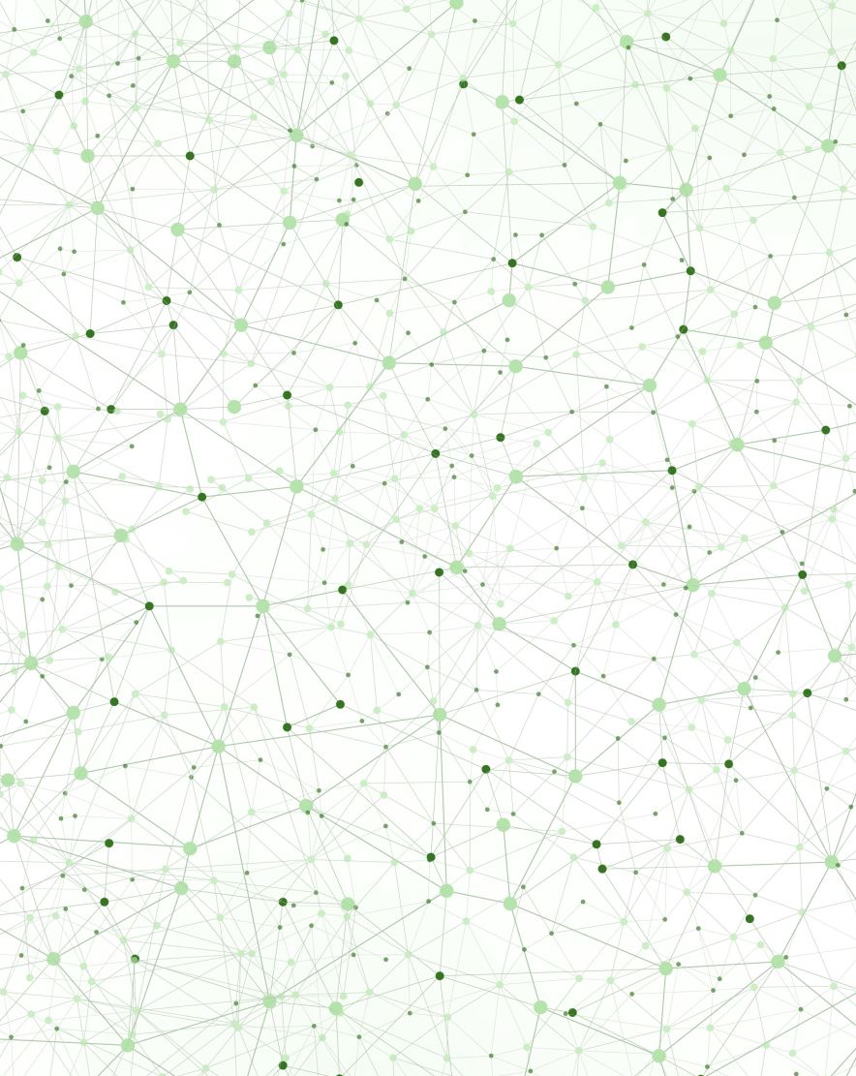
Mol-Optimizer Full Project Presentation
Amit Peled, Daniel Piro,
Shahar Alon & Nofar Rozenberg

Slide 2
What is MolOptimizer (MolOpt)?
MolOpt is a global web-application that developed to be used by researchers working in the field of small fragment-based inhibitors and is intended to be helpful in optimization of ligand databases.
It can be used for Alignment of large ligand datasets, extracting large volume of Chemical Descriptors and training Machine Learning models to predict binding scores.
MolOpt was developed at Akabayov Research Laboratories (at BGU), Under the supervision of Dr. Barak Akabayov.
Notes:
Amit

Slide 3
Project’s Motivation
Our motivation was to create the most user-friendly, easy to use web-application that will allow users from all over the globe to use the MolOptimizer tool.
We hope that this web-application will help anyone who use it, to achieve the best results he can get in the field of small fragment-based inhibitors.
Notes:
Amit

Slide 4
Project’s Main Requirements & Achievements
New Advanced, User Friendly & Responsive UI
Adding Users & Algorithm Runs Managements
Adding New Database To The System
Converting The System Into Global & Accessible System
Algorithms Improvements & Optimizations.
Fully Tested & Easy To Maintain/Add-on Web-Application.
Notes:
Amit

Slide 5
Project’s Technical Information
On the frontend side
We used React JS and Material UI.
We used them for 2 main reasons:
React JS has the advantage to be connected easily to any backend code (based on previous experience we knew to use it for our purposes).
We found Material UI (MUI) to be the best package for a great looking and a user-friendly user-interface.
On the backend side
We used python (Django).
The main reason we use it was because the previous version of MolOpt was written in Python.
Therefore, we found it right to keep using Python in the current version of MolOpt.
Notes:
Amit

Slide 6
User Interface
Frontend based on React JS & material UI.
UI code is fully integrated with all backend code.
User-friendly, Quick, Responsive user interface.
Adjustable, fit & tested with every available web-browser.
Notes:
Daniel

Slide 7
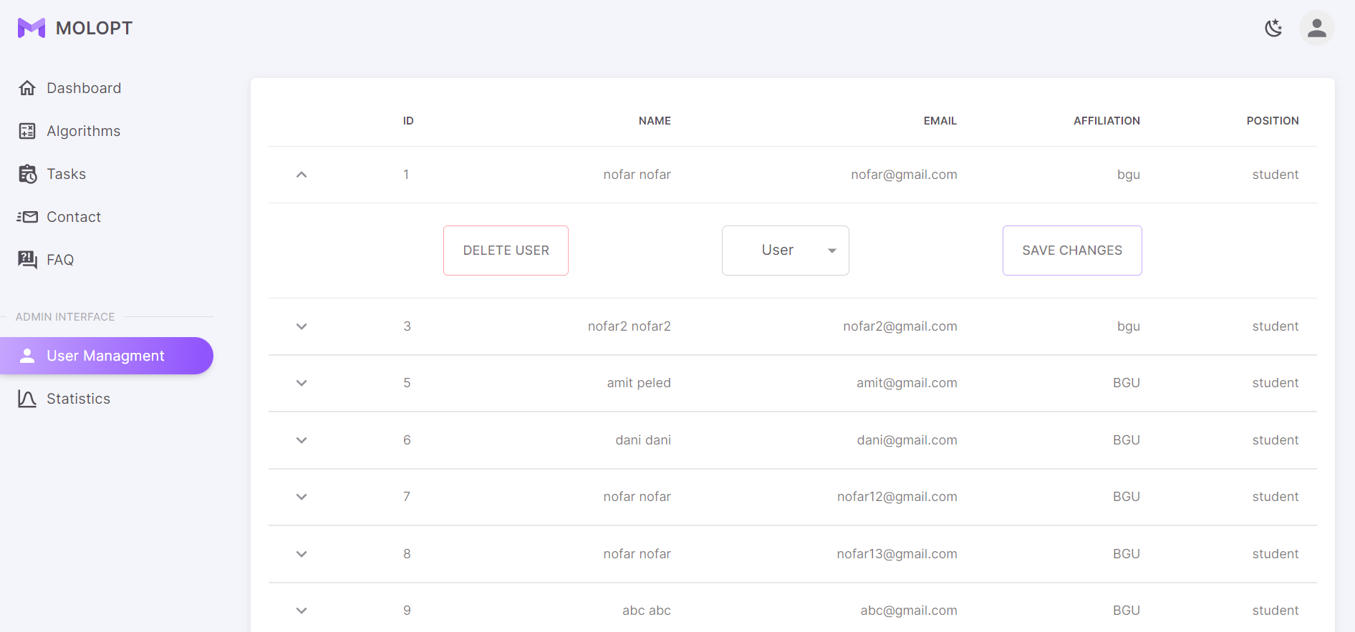
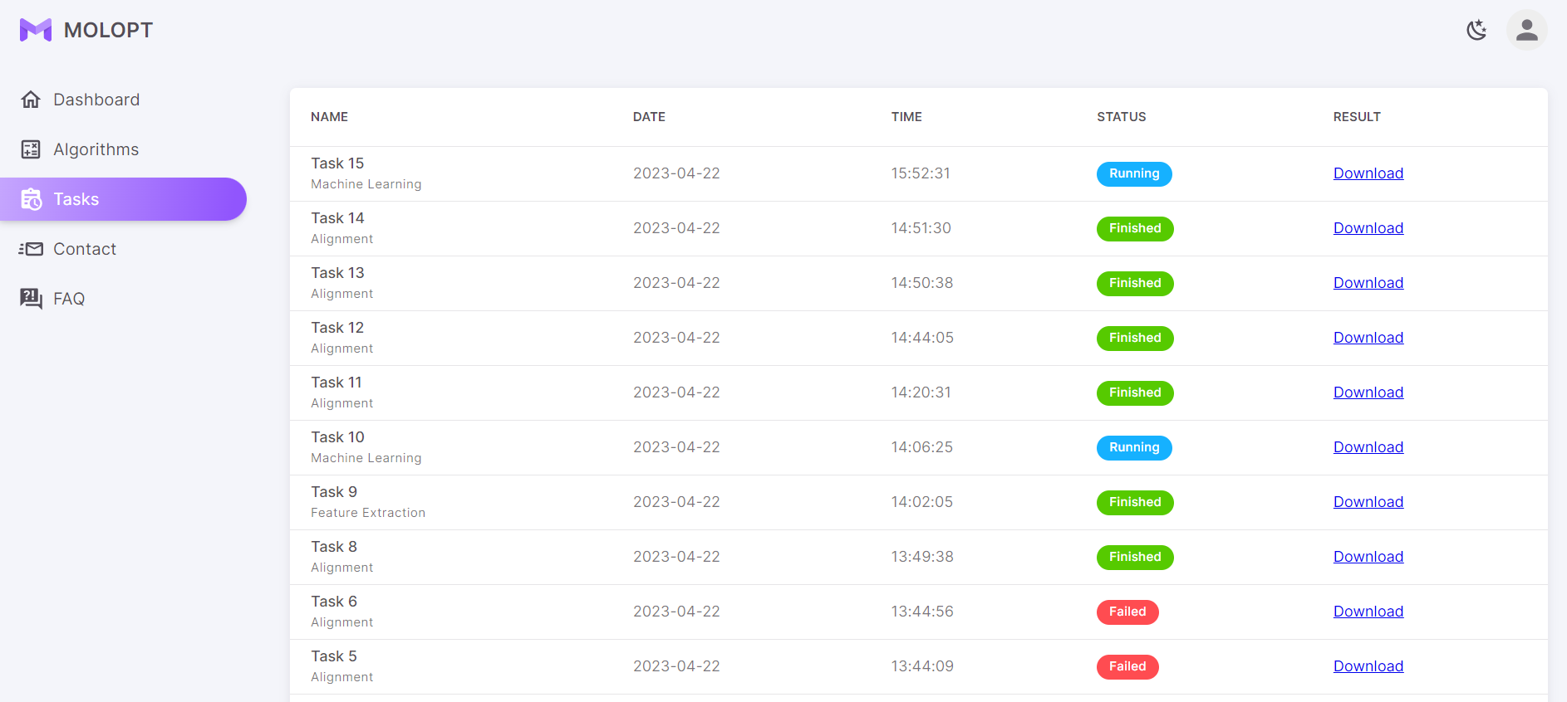
User Management & Runs Management
Photo of the users list (for admin only)
Photo of the tasks list (admin/regular user)
Notes:
Nofar

Slide 8
System’s Database
Capable for saving and working with multiple users and runs in the system.
Storing all the data of users and algorithm runs.
Kept updated at all times.
Notes:
Nofar

Slide 9
Converting The Application Into Global & Accessible Web-Application
At the beginning: MolOptimizer was a simple application that can be ran only locally from the labs’ computers.
Nowadays (At the end): MolOptimizer has become an upgraded web-application that can be run from anywhere and from any PC.
Notes:
Shahar / Daniel

Slide 10
Algorithms Improvements & Optimizations
Upgraded into a thread-based application.
Designing & implementing an algorithm runs queue.
Optimizing the old algorithms code (for better performances).
Supporting all the features of the old version of MolOpt: Alignment, Feature Extraction & Machine Learning Algorithms.
Adding new run called “Auto-Process” to the system.
Notes:
Shahar

Slide 11
System’s Tests/Maintenance/Add-ons
This projects followed by many documentations and tests that will allow the client to always keep the application fully functional.
Maintenance
The project is written in generic and easy to read way that will allow to add future features easily.
Easy To Add-on
Used Django tests system. Testing all the APIs that exists in the application.
Backend Tests
Used Cypress package. Testing many cases of user usages.
Frontend Tests
Notes:
Amit

Slide 12

Thank You! ☺

